Slide 1
CPSC3300: Computer Systems Organization
Lectures 17 & 18 – Memory Overview

Slide 2
Von-Neumann Architecture and Components
Computer
Keyboard, Mouse
Processor
(active)
Memory
(passive)
(where
programs,
data
live when
running)
Devices
Disk (where
programs,
data
live when
not running)
Control
(“brain”)
Input
Datapath
(“brawn”)
Output
Display, Printer
We are finished with processor: control and datapath
Move to memory
How did we use memory in the datapath?
How many cycles does it take for the mem stage?

Slide 3
The Processor-DRAM Performance Gap
Typical CPU clock rate
1-4 GHz (< 1ns cycle time)
Typical DRAM access time
30 ns (> 30 cycles)
Typical main memory access
200ns (DRAM access time, precharge, chip crossing, overhead)
Our pipeline designs assume 1 cycle access
The problem gets worse: CPUs faster, memories bigger (slow)
Solution: big memories are slow, small memories can be made fast

Slide 4








Eight Great Ideas
Design for Moore’s Law
Use abstraction to simplify design
Make the common case fast
Performance via parallelism
Performance via pipelining
Performance via prediction
Hierarchy of memories
Dependability via redundancy

Slide 5
Principle of Locality
Programs access a small proportion of their address space at any time
Temporal locality
Items accessed recently are likely to be accessed again soon
e.g., instructions in a loop, induction variables
Spatial locality
Items near those accessed recently are likely to be accessed soon
E.g., sequential instruction access, array data

Slide 6
Memory Hierarchy Pyramid
Processor (CPU)
transfer datapath: bus
Decreasing distance
from CPU, Decreasing Access Time (Memory Latency)
Level 1
Increasing Distance from CPU, Decreasing cost / MB
Level 2
Level 3
. . .
Level n
Size of memory at each level

Slide 7
Memory
a memory – a logical k × m array of stored bits.
Address Space:
number of locations (usually a power of 2)
k = 2^{n}
locations
•
•
•
Addressability:
number of bits per location (e.g., byte-addressable)
m bits

Slide 8
Memory Organization Example
Example memory contents:
A memory with 3 address bits & 8 data bits has:
k = 3 and n = 8 so 2³ = 8 addresses labeled 0 to 7.
2³ = 8 words of 8-bit data
Memory Address
Memory
Binary Decimal
Content
0 0 0 0
1 0 0 0 1 1 1 1
0 0 1 1
1 1 1 1 1 1 1 1
0 1 0 2
1 0 1 1 0 0 0 1
0 1 1 3
0 0 0 0 0 0 0 0
1 0 0 4
1 0 1 1 1 0 0 1
1 0 1 5
1 0 0 0 0 1 1 0
1
1 0 6
0 0 1 1 0 0 1 1
1 1 1 7
1 1 0 0 1 1 0 0

Slide 9
Basic Memory Operations
Memory operations 3-tuple:
Data ─ written to or read from memory
Address ─ specifies memory location
Command ─ READ or WRITE

Slide 10
RAM Integrated Circuits
Types of random access memory
Static – information stored in latches
Dynamic – information stored as electrical charges on capacitors
Charge “leaks” off
Periodic refresh of charge required
Dependence on Power Supply
Volatile – loses stored information when power turned off
Non-volatile – retains information when power turned off

Slide 11
Memory Technology
Static RAM (SRAM)
0.5ns – 2.5ns, $500 – $1,000 per GB
Dynamic RAM (DRAM)
50ns – 70ns, $3 – $10 per GB
Flash Memory
0.005ms – 0.05ms, $0.25 - $0.75 per GB
Magnetic disk
5ms – 20ms, $0.02 – $0.05 per GB
Ideal memory
Access time of SRAM
Capacity and cost/GB of disk

Slide 12
SRAM
Array of storage cells used to implement static RAM
Storage Cell
SR Latch
Select input for control
Dual Rail Data Inputs B and B
Dual Rail Data Outputs C and C
Select
B
S
Q
C
C
B
R
Q
RAM cell

Slide 13
Dynamic RAM (DRAM)
Basic Principle: Storage of information on capacitors.
Charge and discharge of capacitor to change stored value
Use of transistor as “switch” to:
Store charge
Charge or discharge

Slide 14
Dynamic RAM (continued)
Select
Stored 1
Stored 0
T
To Pump
B
C
DRAM cell
(a)
(b)
(c)
Write 1
Write 0
Select
D
(d)
(e)
B
Q
C
Read 1
Read 0
C
DRAM cell
model
(h)
(f)
(g)
Notes:
Warning: (d), (e), (f), and (g) are animated. Each animation is triggered with a mouse click
and goes through two steps at 1 second intervals.

Slide 15
Current Memory Hierarchy
Processor
Control
Secon-
dary
Mem-
ory
Main
Mem-
ory
L2
Cache
L3
Cache
Data- path
L1 cache
regs
Speed(ns): 0.5ns 1.5ns 5ns 50ns 10,000,000ns Size (MB): 0.0005 0.1 1-4 128-32,768 1,000,000 Cost ($/GB): -- $1,500 $500 $5 < $0.05 Technology: Regs SRAM SRAM DRAM Disk
Notes:
Instead, the memory system of a modern computer consists of a series of black boxes ranging from the fastest to the slowest.
Besides variation in speed, these boxes also varies in size (smallest to biggest) and cost.
What makes this kind of arrangement work is one of the most important principle in computer design. The principle of locality.
+1 = 7 min. (X:47)

Slide 16

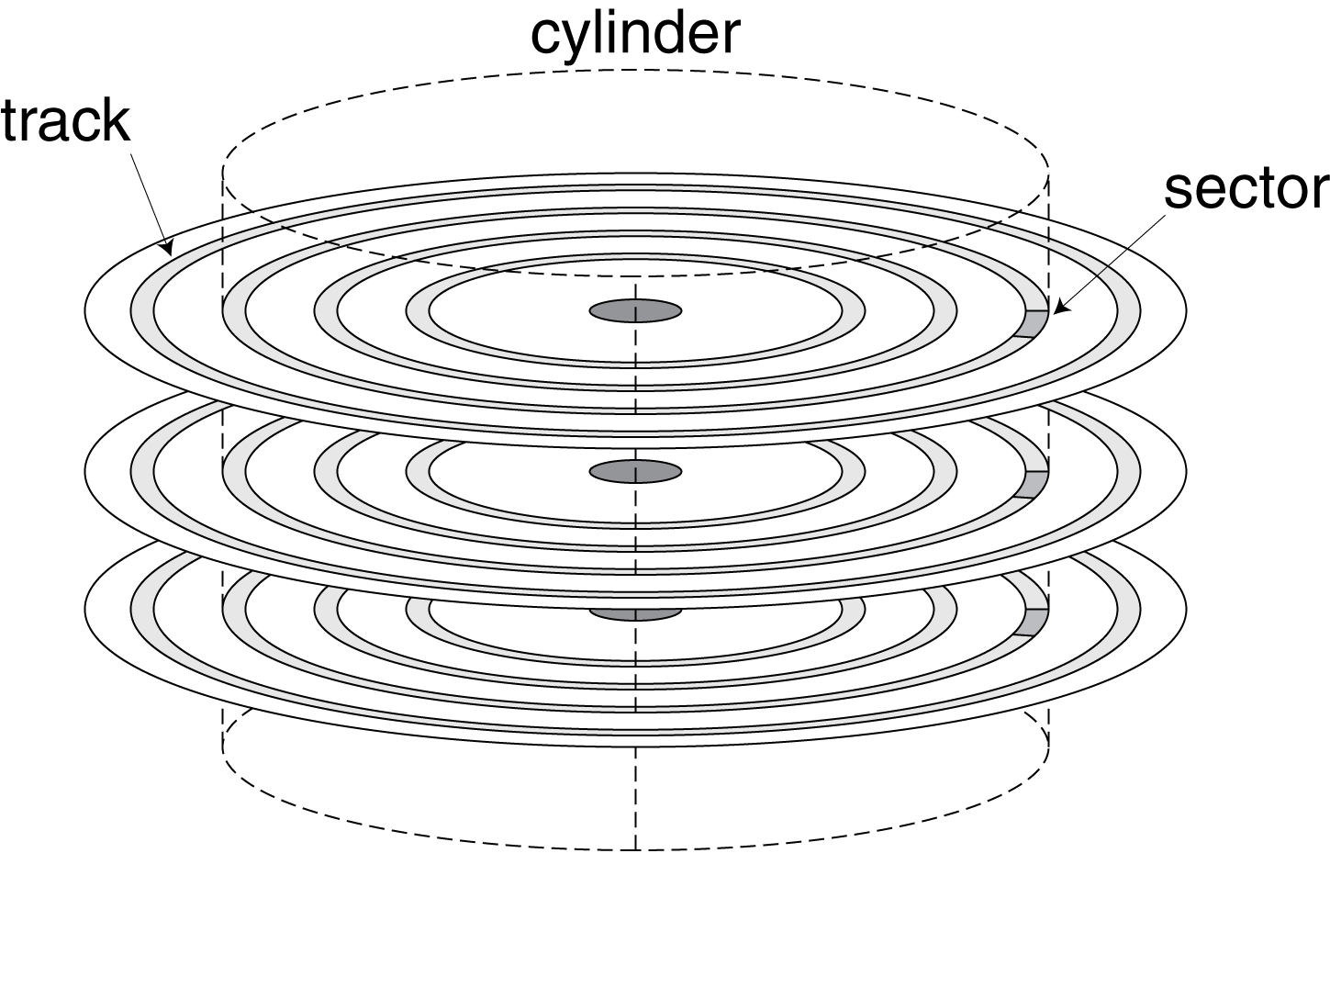
Disk Storage
Nonvolatile, rotating magnetic storage

Slide 17
Disk Sectors and Access
Each sector records
Sector ID
Data (512 bytes, 4096 bytes (Advanced Format))
Error correcting code (ECC)
Used to hide defects and recording errors
Synchronization fields and gaps
Access to a sector involves
Queuing delay if other accesses are pending
Seek: move the heads
Rotational latency
Data transfer
Controller overhead

Slide 18
Disk Access Example
Given
512B sector, 15,000rpm, 4ms average seek time, 100MB/s transfer rate, 0.2ms controller overhead, idle disk
Average read time
4ms seek time + ½ / (15,000/60) = 2ms rotational latency + 512 / 100MB/s = 0.005ms transfer time + 0.2ms controller delay = 6.2ms
If actual average seek time is 1ms
Average read time = 3.2ms

Slide 19
Taking Advantage of Locality
Memory hierarchy
Store everything on disk
Copy recently accessed (and nearby) items from disk to smaller DRAM memory
Main memory
Copy more recently accessed (and nearby) items from DRAM to smaller SRAM memory
Cache memory attached to CPU

Slide 20
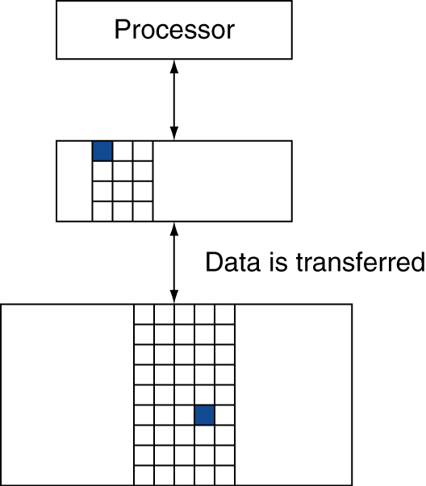
Memory Hierarchy Levels
Block (aka line): unit of copying
May be multiple words
If accessed data is present in upper level
Hit: access satisfied by upper level
Hit ratio: hits/accesses
If accessed data is absent
Miss: block copied from lower level
Time taken: miss penalty
Miss ratio: misses/accesses = 1 – hit ratio
Then accessed data supplied from upper level

Slide 21
Sample Cache Performance
Data size
L3 miss penalty
L2 miss penalty
L1 miss penalty
L1 miss penalty
L1 hit time

Slide 22
Administrivia
Exam II
Tuesday, April 3
Covering materials up through lecture 16 (Real Processor Design Examples), end of chapter 4 (after exam I)
Study guide (exam II review / outline of topics) and a sample exam will be available on canvas
Homework solutions will be made available on canvas

Slide 23
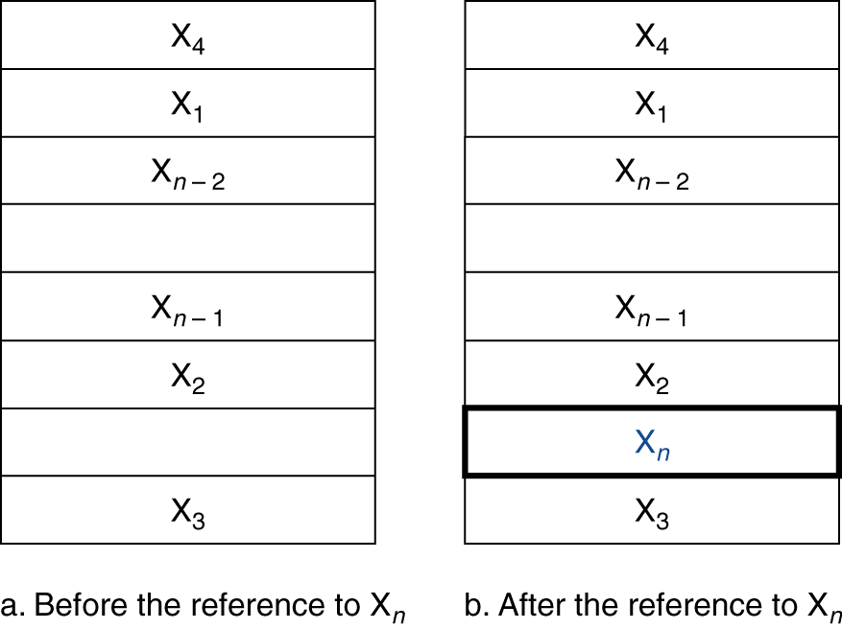
Cache Memory
Cache memory
The level of the memory hierarchy closest to the CPU
Given accesses X₁, …, X_{n–1}, X_{n}
§5.3 The Basics of Caches
How do we know if the data is present?
Where do we look?

Slide 24
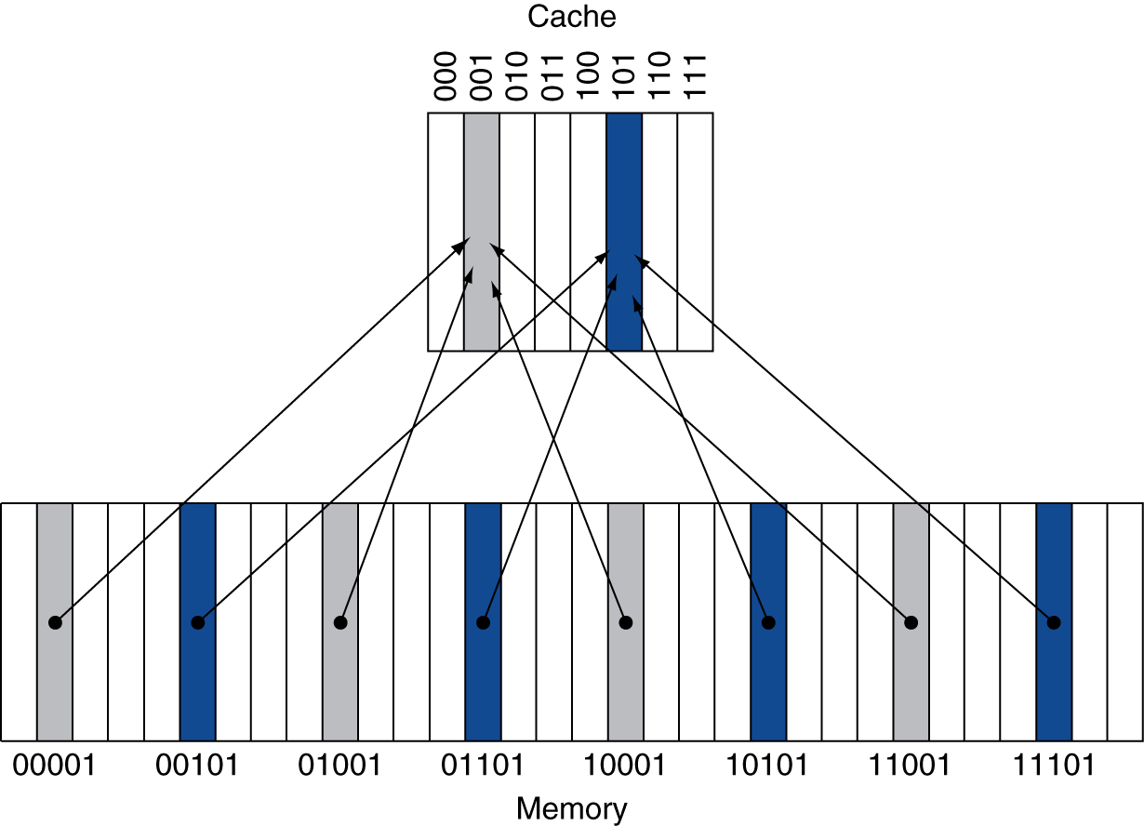
Direct Mapped Cache
Location determined by address
Direct mapped: only one choice
(Block address) modulo (#Blocks in cache)
#Blocks is a power of 2
8 in the example
Use low-order address bits
Multiple blocks in lower level map to the same cache location
4 → 1 in the example

Slide 25
Tags and Valid Bits
How do we know which particular block is stored in a cache location?
Store block address as well as the data
Actually, only need the high-order bits
Called the tag
What if there is no data in a location?
Valid bit: 1 = present, 0 = not present
Initially 0

Slide 26
Cache Example
8-blocks, 1 word/block, direct mapped
1 word = 4 bytes
Initial state
Index | V | Tag | Data
000 | N
001 | N
010 | N
011 | N
100 | N
101 | N
110 | N
111 | N

Slide 27
Cache Example
Word addr | Binary addr | Hit/miss | Cache block
22 | 10 110 | Miss | 110
Index | V | Tag | Data
000 | N
001 | N
010 | N
011 | N
100 | N
101 | N
110 | N
111 | N
Index | V | Tag | Data
000 | N
001 | N
010 | N
011 | N
100 | N
101 | N
110 | Y | 10 | Mem[10110]
111 | N

Slide 28
Cache Example
Word addr | Binary addr | Hit/miss | Cache block
26 | 11 010 | Miss | 010
Index | V | Tag | Data
000 | N
001 | N
010 | N
011 | N
100 | N
101 | N
110 | Y | 10 | Mem[10110]
111 | N
Index | V | Tag | Data
000 | N
001 | N
010 | Y | 11 | Mem[11010]
011 | N
100 | N
101 | N
110 | Y | 10 | Mem[10110]
111 | N

Slide 29
Cache Example
Word addr | Binary addr | Hit/miss | Cache block
22 | 10 110 | Hit | 110
26 | 11 010 | Hit | 010
Index | V | Tag | Data
000 | N
001 | N
010 | Y | 11 | Mem[11010]
011 | N
100 | N
101 | N
110 | Y | 10 | Mem[10110]
111 | N

Slide 30
Cache Example
Word addr | Binary addr | Hit/miss | Cache block
16 | 10 000 | Miss | 000
3 | 00 011 | Miss | 011
16 | 10 000 | Hit | 000
Index | V | Tag | Data
000 | Y | 10 | Mem[10000]
001 | N
010 | Y | 11 | Mem[11010]
011 | Y | 00 | Mem[00011]
100 | N
101 | N
110 | Y | 10 | Mem[10110]
111 | N

Slide 31
Cache Example
Word addr | Binary addr | Hit/miss | Cache block
18 | 10 010 | Miss | 010
Index | V | Tag | Data
000 | Y | 10 | Mem[10000]
001 | N
010 | Y | 10 | Mem[10010]
011 | Y | 00 | Mem[00011]
100 | N
101 | N
110 | Y | 10 | Mem[10110]
111 | N

Slide 32
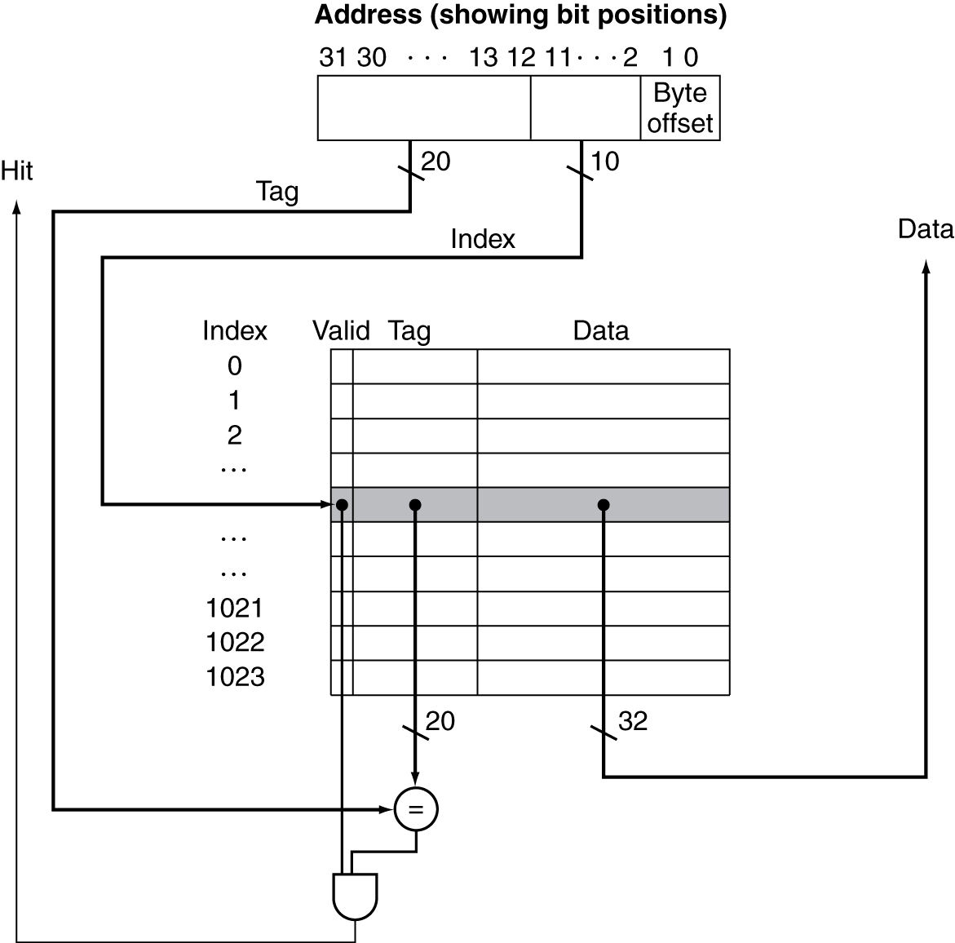
Address Subdivision
2^10 entries in the cache
Each entry: 20-bit tag, 32-bit (4 bytes) data, 1-bit valid

Slide 33
Example: Larger Block Size
Given a 32-bit machine
64 blocks in the direct mapped cache, 16 bytes/block
To what block number does address 1200 map?
To answer this question, how many bits for tag, index, and offset?
31
10
9
4
3
0
Tag
Index
Offset
22 bits
6 bits
4 bits
(1200)₁₀ = (01 001011 0000)₂
tag index offset
01 11 0

Slide 34
Block Size Considerations
Larger blocks should reduce miss rate
Due to spatial locality
But in a fixed-sized cache
Larger blocks ⇒ fewer of them
More competition ⇒ increased miss rate
Larger blocks ⇒ pollution
Larger miss penalty
Can override benefit of reduced miss rate
Early restart and critical-word-first can help

Slide 35
Reducing Cache Misses
Instructions
Reorder procedures in memory so as to reduce misses
Profiling to look at conflicts
McFarling [1989] reduced caches misses by 75% on 8KB direct mapped cache with 4 byte blocks
Data
Increase temporal and spatial locality in algorithms

Slide 36
Summary
Locality
Temporal locality and spatial locality
Memory hierarchy
Direct mapped cache

